Slide 1




Multi-Stage image Restoration &
Enhancement
M.Ahmed Naseer

Slide 2
Multi-Stage image Restoration &
Enhancement
M.Ahmed Naseer

Slide 3


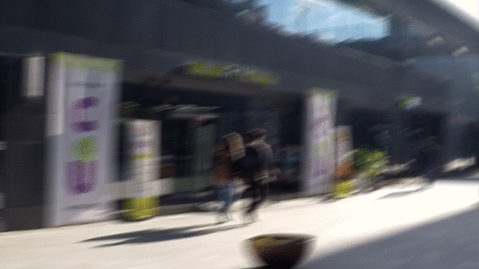
Project Statement
Project include image restoration like deblurring,
Denoising, De-raining, resolution improvement and image enhancement

Slide 4
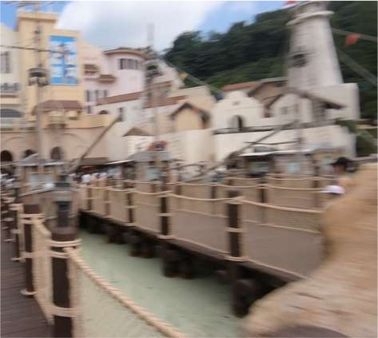
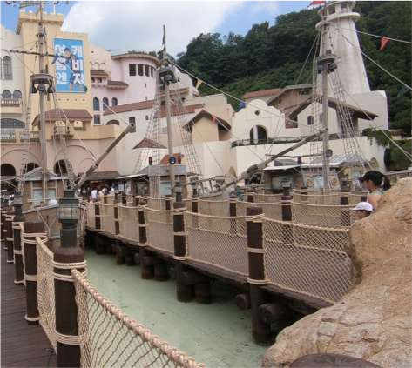
Input & Output
Input Include in this project
Deblurring
Blur image
Sharp image

Slide 5
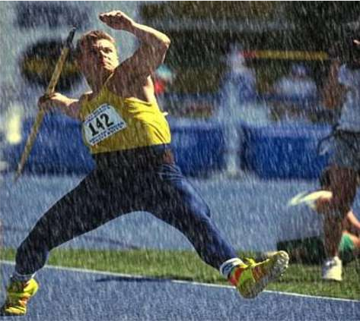
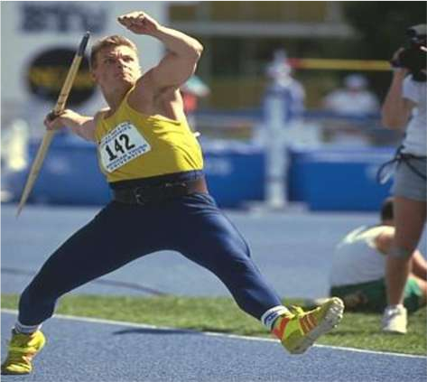
Input & Output
Input Include in this project
Deraining
rainy image
Rain Free image

Slide 6
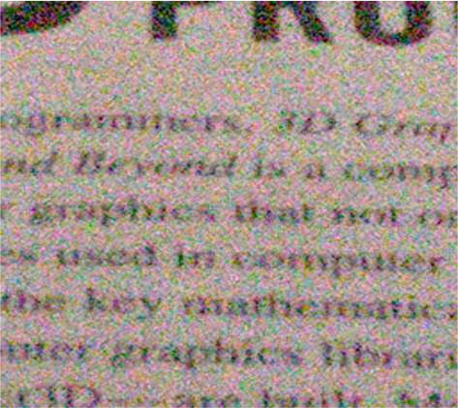
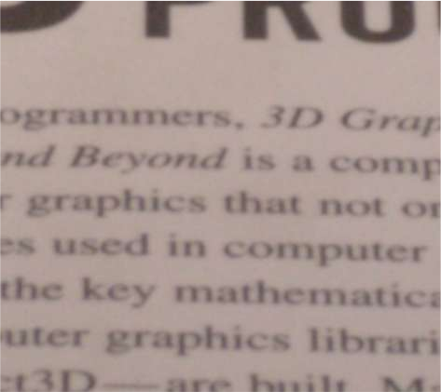
Input & Output
Input Include in this project are images and videos
Deblurring
Blur image
Sharp image

Slide 7
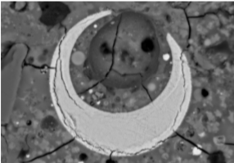
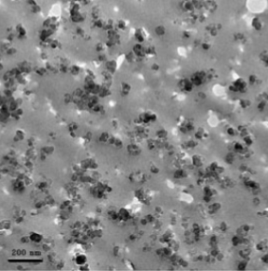

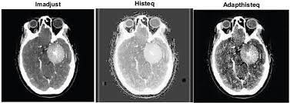
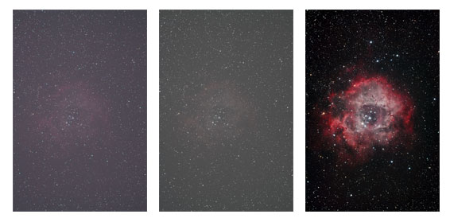
Applications
Material science
Medical Imaging
Astronomical Imaging
Forensic Science

Slide 8
THANKS
YOU

